Slide 1
Broken Electric Appliance Transport Service
106034071 廖允寬
106034076 麥祐嘉
106034077 張祐綱

Slide 2
1
Background review
2
IPO Cycle
Contents
3
More detail & diagram
4
Design

Slide 3
Background review
The system called “Broken electric appliance transport service”.
The service will help customers to transport their broken item and send it back when fixed.
Customers just need to stay home and wait for their item be repaired.

Slide 4
Input
Process
Output
A Broken product
Repair sheet
Send product to the repair shop
Repair the product
Send the product back and charge for shipping
A repaired product

Slide 5
More detail
If the first repair shop can't fix it, post office will ask customer whether to send it to the next repair shop.
-> if yes, the item will be sent to next repair shop (freight fee keep as same amount).
-> if no, the item will be sent back to customer and still need to pay freight fee .
If the item have some accidents during the transport, post office will have an upper bound for compensation (decide by the product's type).

Slide 6

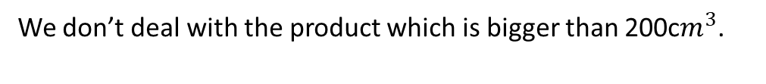
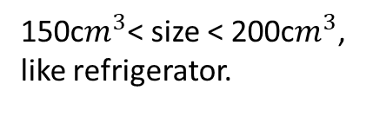
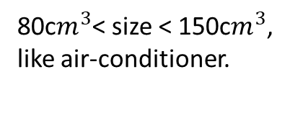
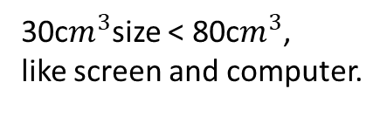
Charge
Besides repair cost, we took the shipping fee from customers decided by size of the item.
$100
$300
size <30 c$m^{3}$ ,
like headset and cellphone.
80c$m^{3}$< size < 150c$m^{3}$,
like air-conditioner.
Charge
30c$m^{3}$size < 80c$m^{3}$,
like screen and computer.
150c$m^{3}$< size < 200c$m^{3}$,
like refrigerator.
$200
$400
We don’t deal with the product which is bigger than 200c$m^{3}$.

Slide 7
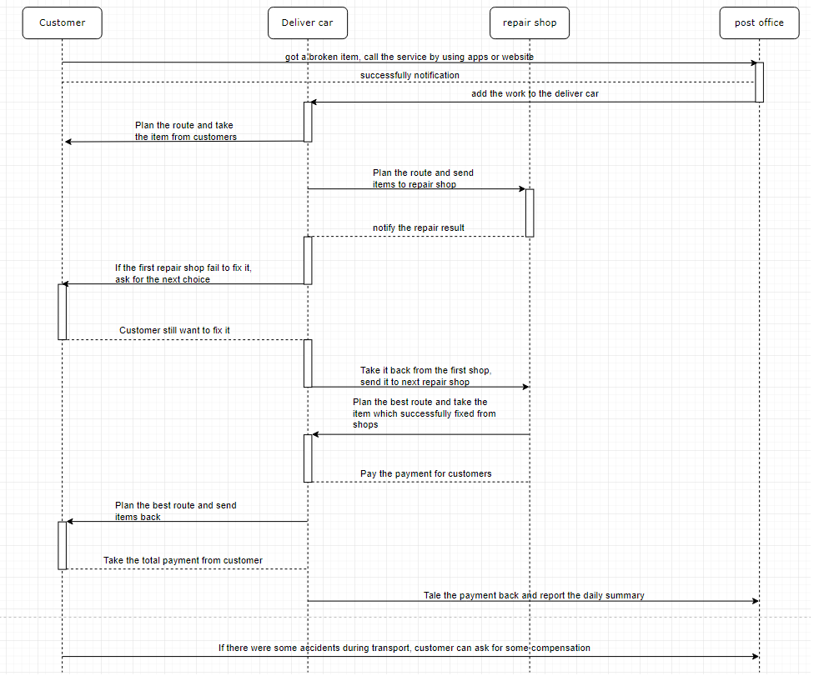

Slide 8
Design(By drawing)

Slide 9
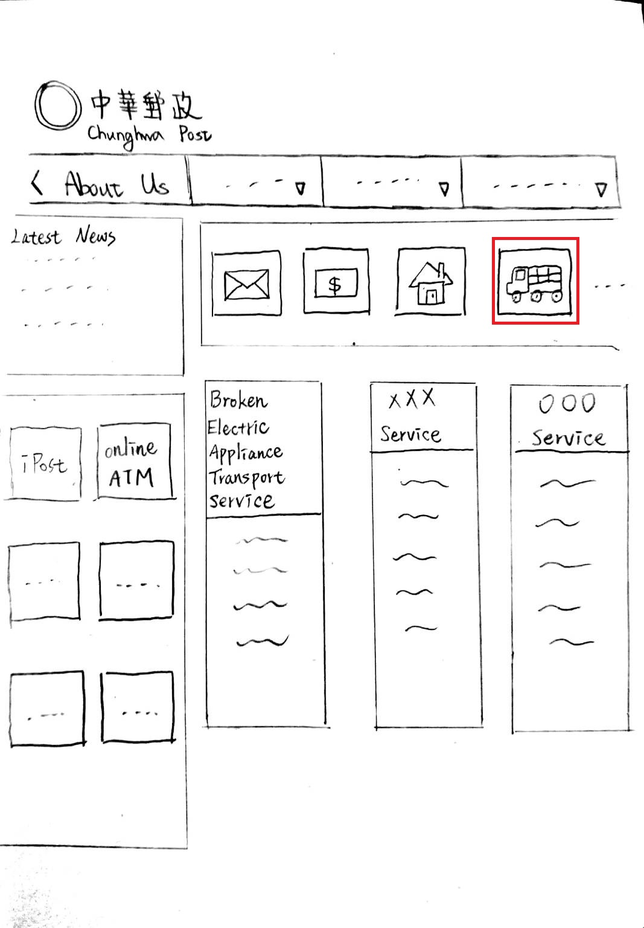
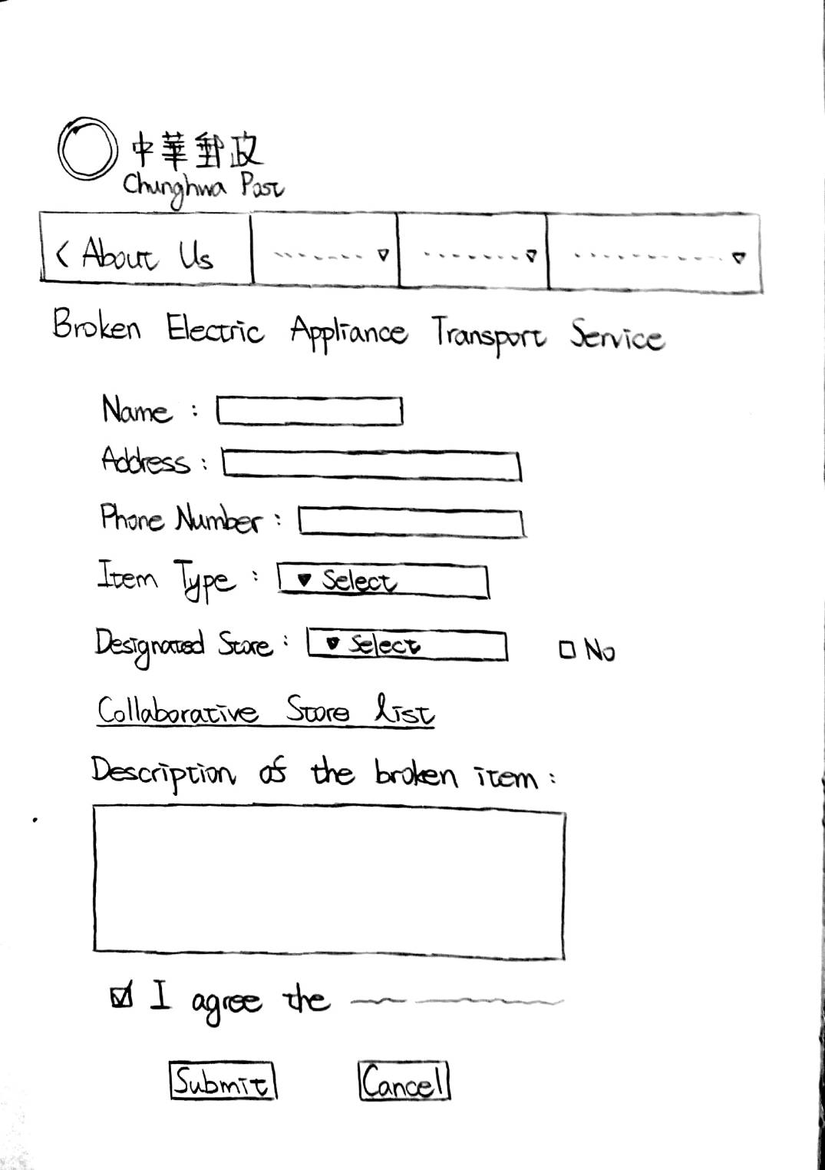

Slide 10
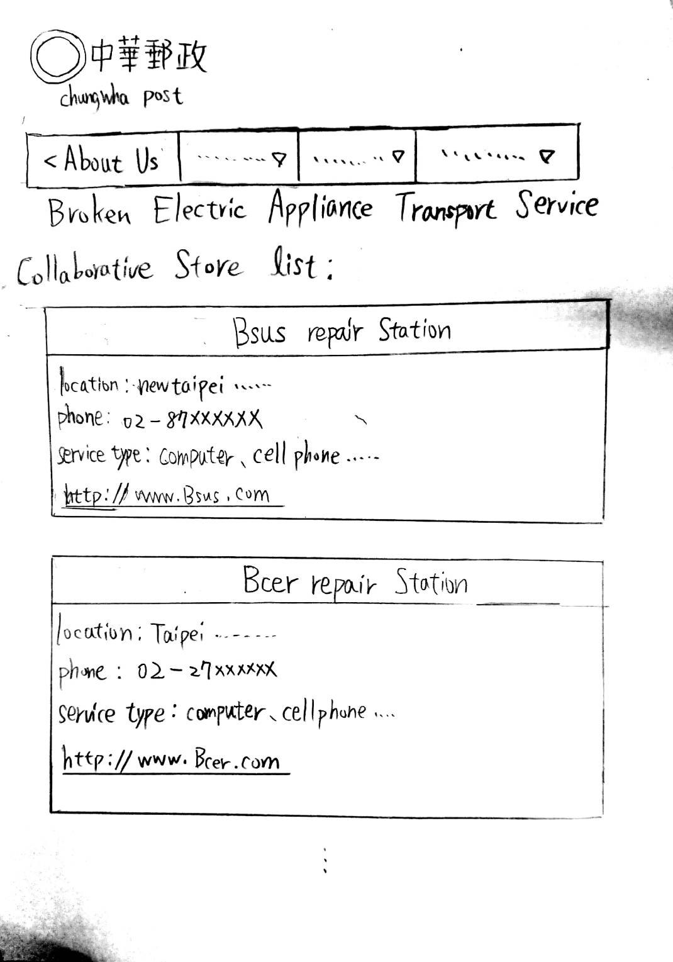
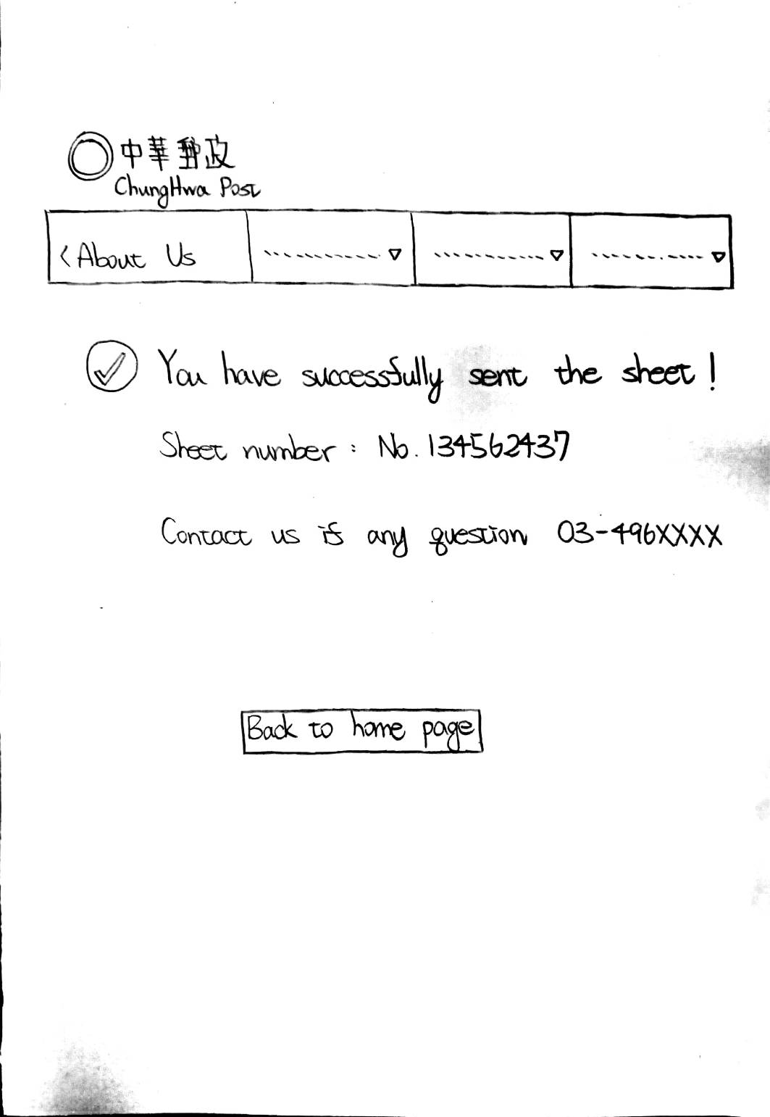

Slide 11
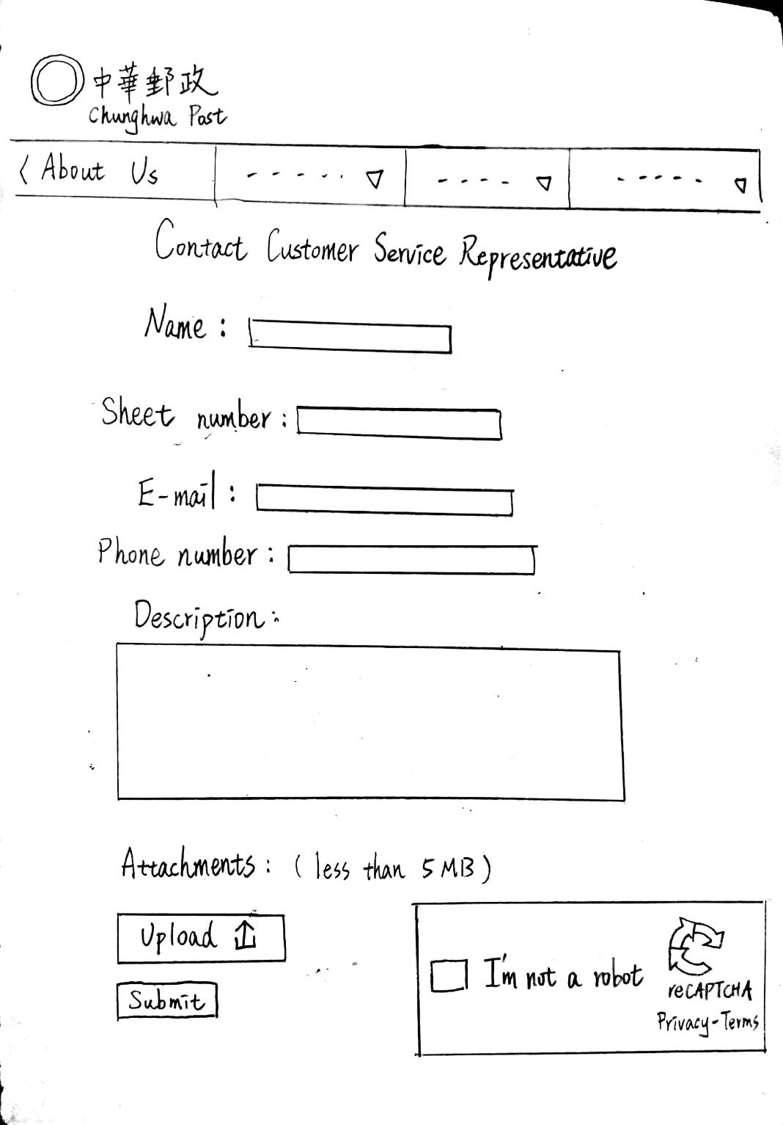
Asking to compensate.
Compare to other companies.

Slide 12
Demo(By C++)

Slide 13
Thank you !

